Slide 1
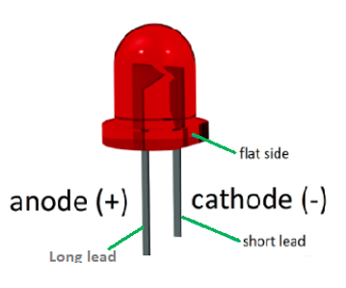

Common Anode
Common anode operation explained: Diodes are wired such that the anodes are connected together. If a positive voltage is supplied to this common anode then completing the circuit by connecting one of the cathodes to the –ve will cause that Led to light. Current limiting resistors are not shown for simplicity.

Slide 2
Common Cathode
Common Cathode operation explained: Similar to the common anode except now the diodes are wired such that their cathodes are connected together. Current limiting resistors are not shown for simplicity.

Slide 3
Back to Back Diodes: Here the LED’s are wired in opposite directions. Which LED lights up will depend on the direction of current flow. The current flow depends on the voltage applied to the two leads. It is not straight forward to change the voltage on one lead and still have both LEDs work. Current limiting resistors are not shown for simplicity.

Slide 4
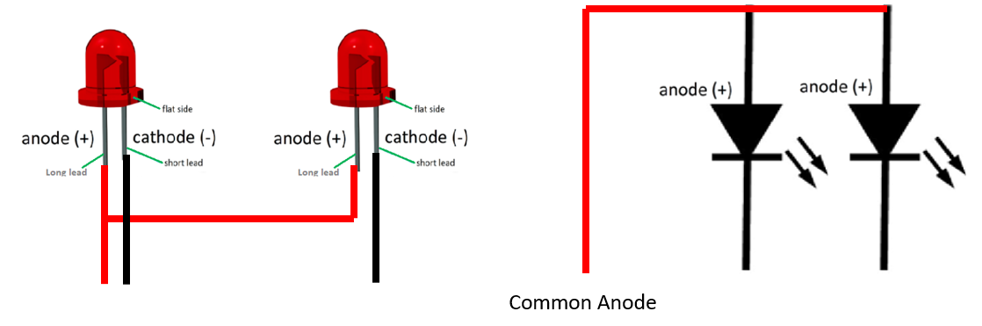
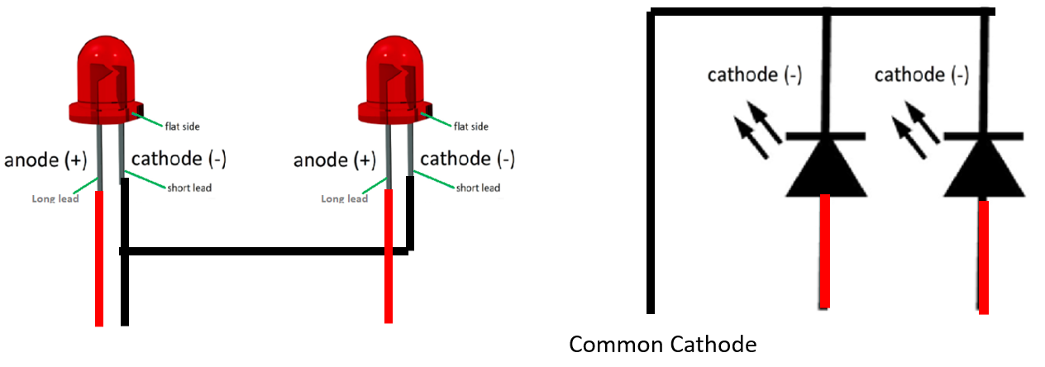
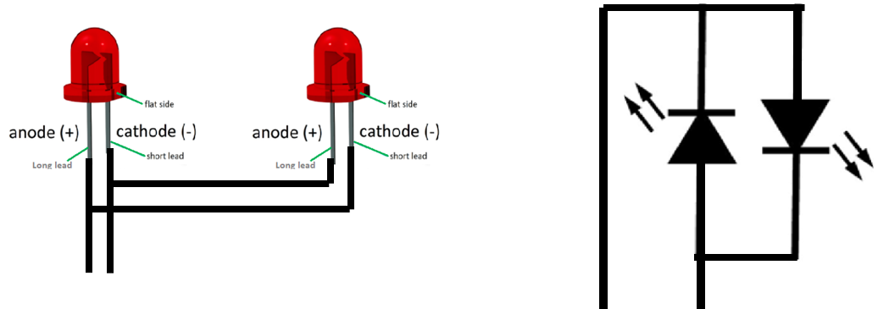
Common Anode explained:
Diodes are wired such that the anodes are connected together. If a positive voltage is supplied to this common anode then completing the circuit by connecting one of the cathodes to the –ve will cause that Led to light. With all LED’s It is important to limit the current flow using a resistor (not shown for simplicity.)
Common Cathode explained:
Similar to the common anode except now the diodes are wired such that their cathodes are connected together.
Back to Back Diodes:
Here the LED’s are wired in opposite directions. Which LED lights up will depend on the direction of current flow. The current flow depends on the voltage applied to the two leads. It is not straight forward to change the voltage on one lead and still have both LEDs work.

